Slide 1
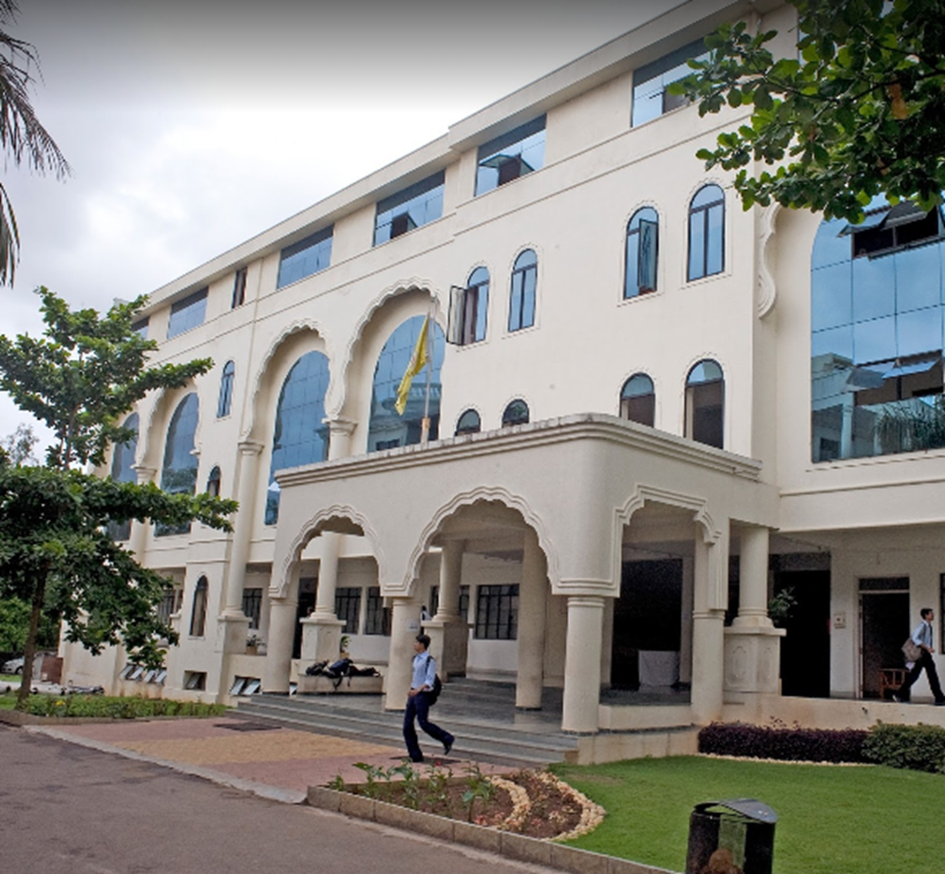


CAPSTONE PROJECT
NAME : Aniket Yadav
PRN : 0120190328
PROGRAM : Bachelor of Technology
DISCIPLINE : Computer Engineering
ACADEMIC YEAR : 2019 - 2023

Slide 2
ABSTRACT
The purpose of this project is to mine rainfall data for Indian states using the dataset as provided on data.gov.in/. The project is divided into two phases. The first phase consists of data cleaning, data pre-processing and preliminary data visualization. The second phase will involve the application of different data mining algorithms and gaining insights from it subsequently. The project also aims at predicting future rainfall trends and provide useful insights in rainfall distribution of Indian Subcontinent. This can further help in policy making and planning by the government.
RAIN FALL PREDICTION USING ML MODELS

Slide 3
Predict coming year's rainfall pattern
Exploring open data @data.gov.in
Visualizing 117 years of data
Identify flood & drought areas
Forming clusters among common states
OBJECTIVES AND GOALS

Slide 4
PROBLEM STATEMENT
To develop ML models that leverage historical data and meteorological parameters to enhance rainfall prediction accuracy and lead time.
ALGORITHMS USED
Linear Regression
DBSCAN

Slide 5
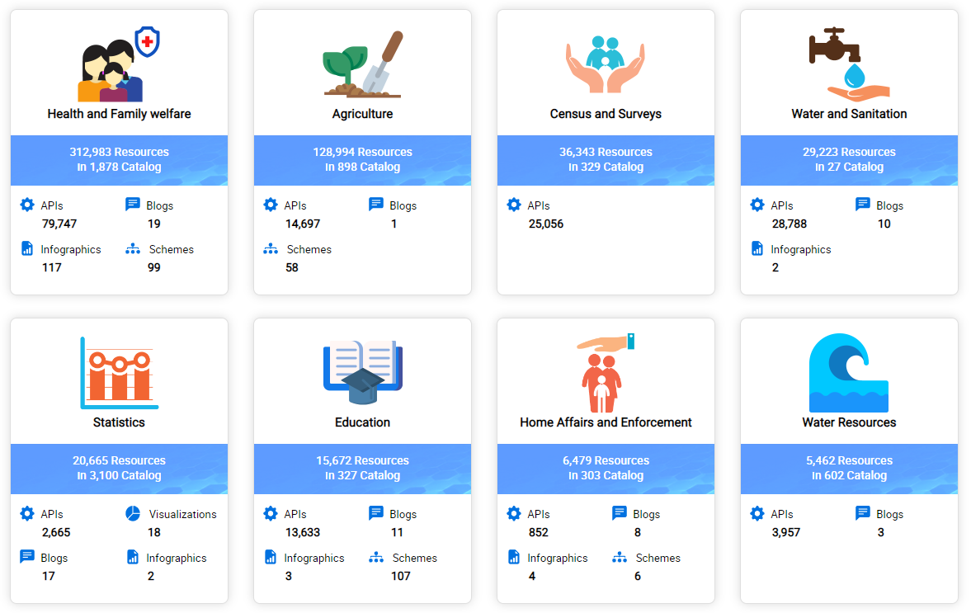
DATA.GOV.IN

Slide 6
RESULT

Slide 7
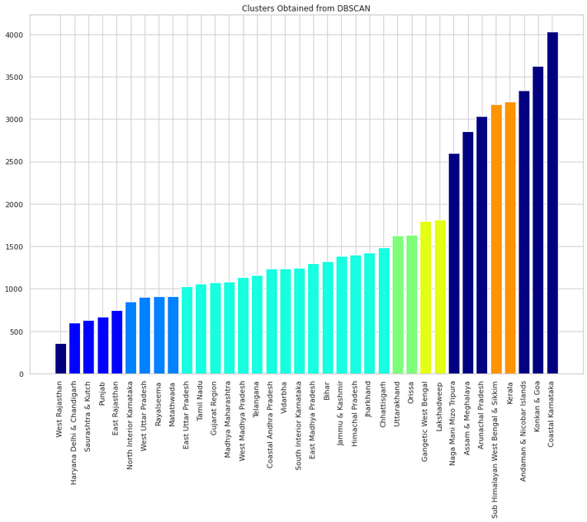
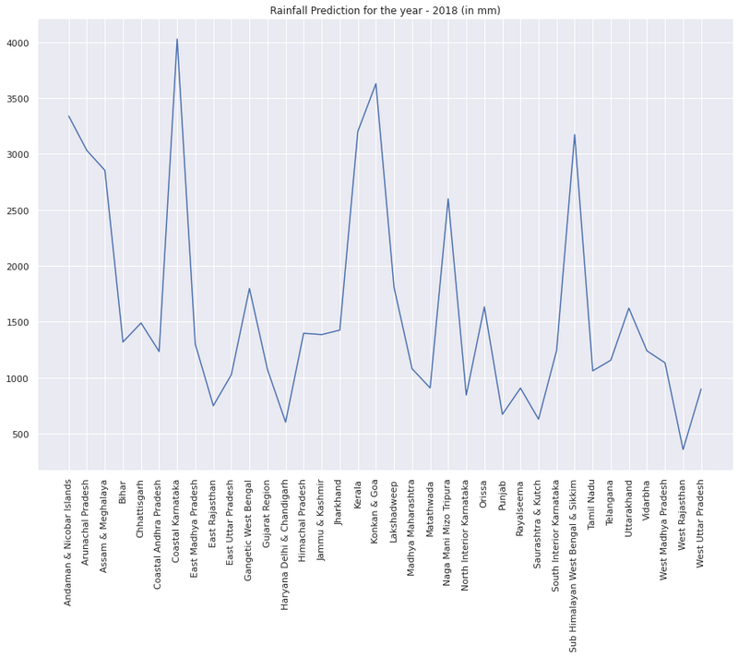
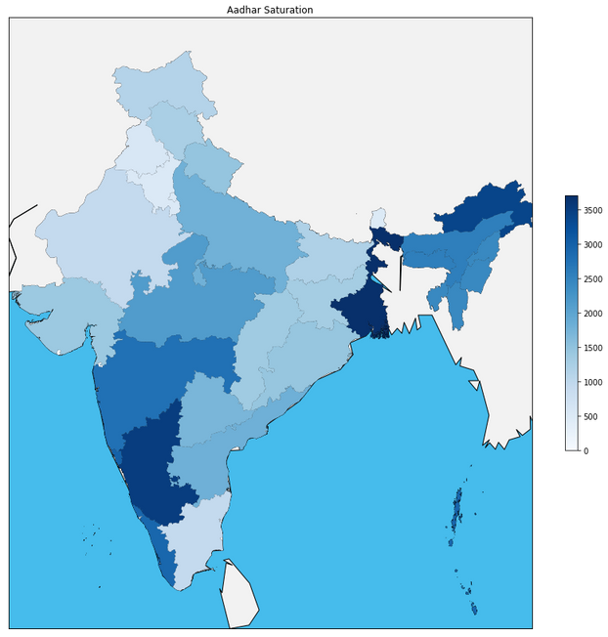
2
RAINFALL
PATTERN SEEN
IN INDIAN
STATES
1
3
CLUSTER FORMATIONS
USING
DBSCAN
PREDICTION FOR 2018 USING
PAST 117 YEARS
OF DATA

Slide 8
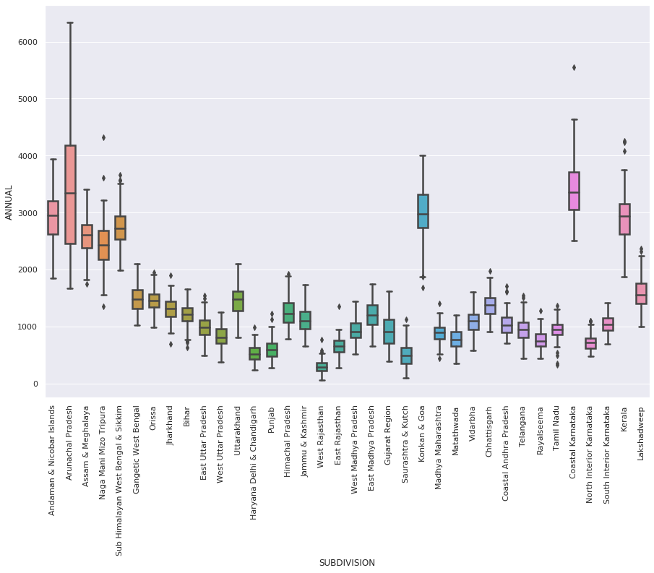
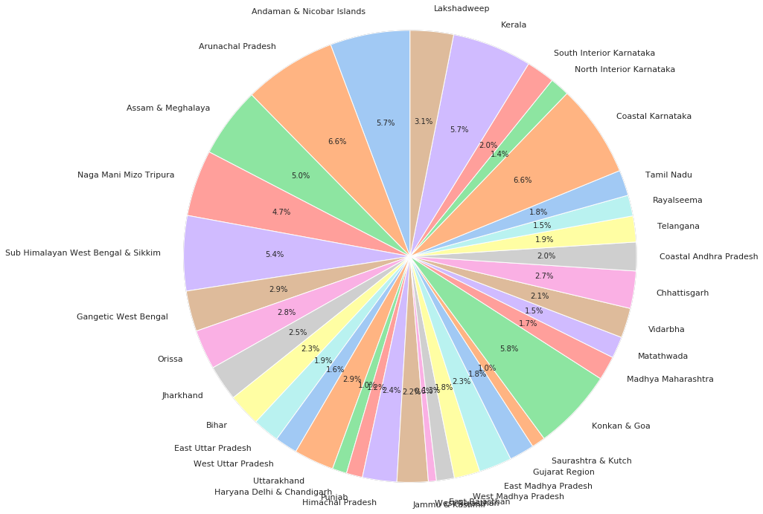
RESULT
% CONTRIBUTION OF MONSOON IN DIFFERENT STATES
ANNUAL RAINFALL STATEWISE

Slide 9

aniketyadav@mitaoe.ac.in
https://aniketyadav.github.io/

